Slide 1

EMOSENSE
SPEECH EMOTION ANALYSIS TOOL
Presented by Dheepan G

Slide 2

Developing a Comprehensive Speech Analysis Tool for Speech-Language Pathologists
INTRODUCTION
Speech-language pathologists (SLPs) play a critical role in diagnosing and treating communication disorders.
This presentation outlines a comprehensive approach to developing a speech analysis tool that captures audio, converts it to text, performs sentiment analysis and identifies the emotional state of the speaker.

Slide 3
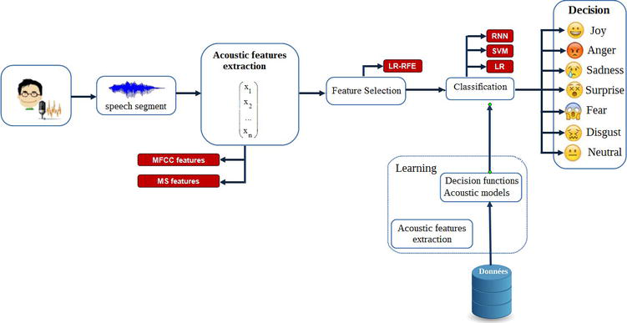
STEPS IN SER
Prepare dataset
Feature extraction
Feature scaling
Split the dataset
Choose a classifier
Train the classifier
Evaluate the model
Fine tuning and optimization
Predict emotions

Slide 4
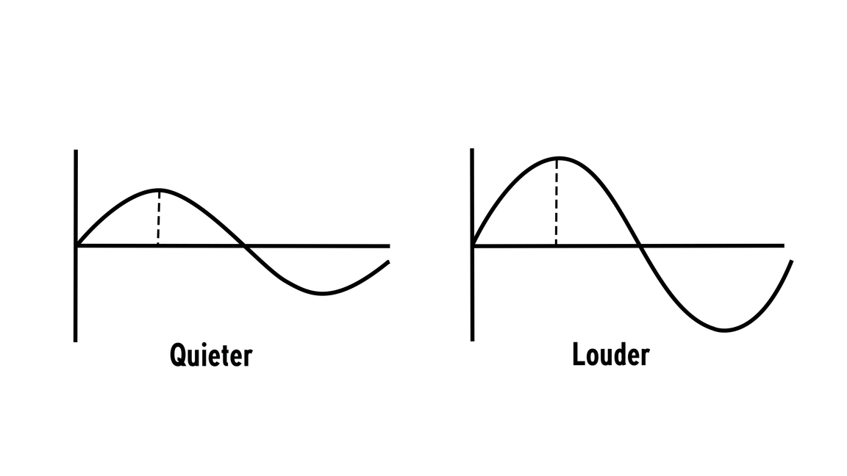
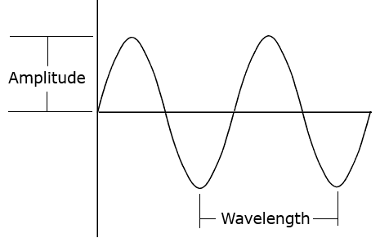
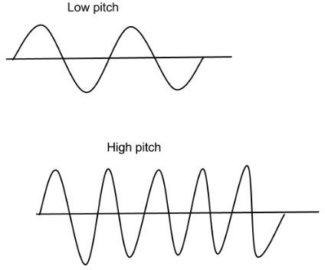
Feature Extraction
Intensity
Sound wave
Pitch

Slide 5
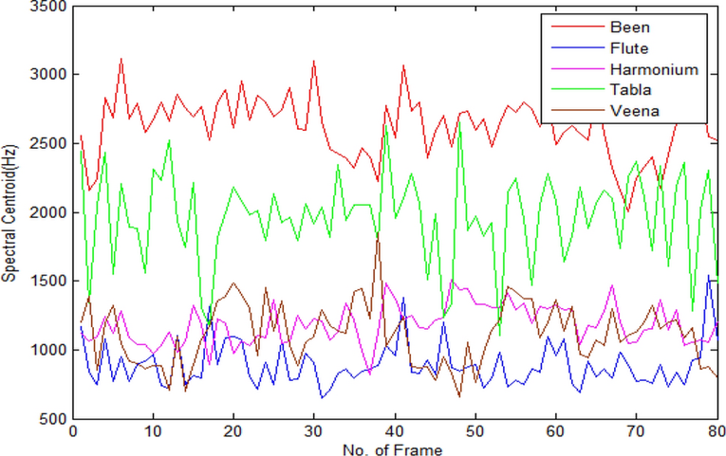
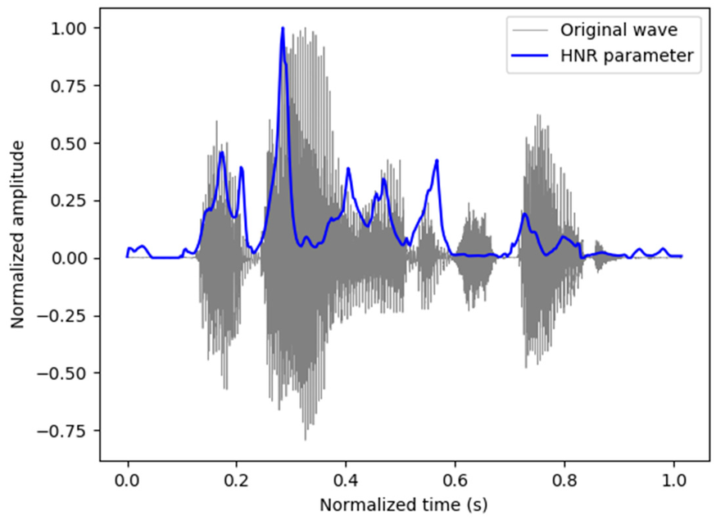
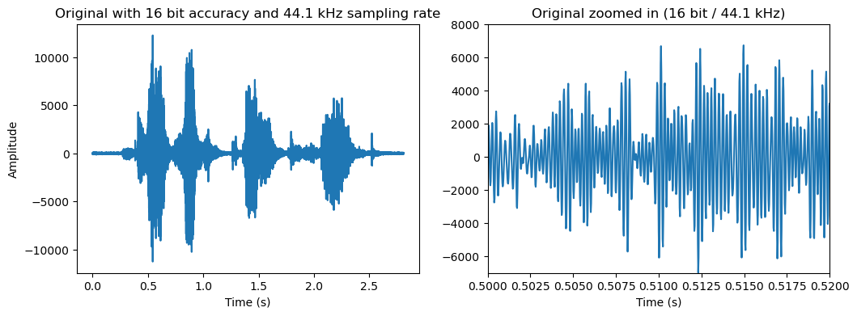
Harmonic to noise ratio
Spectral Centroid
Sampling rate

Slide 6
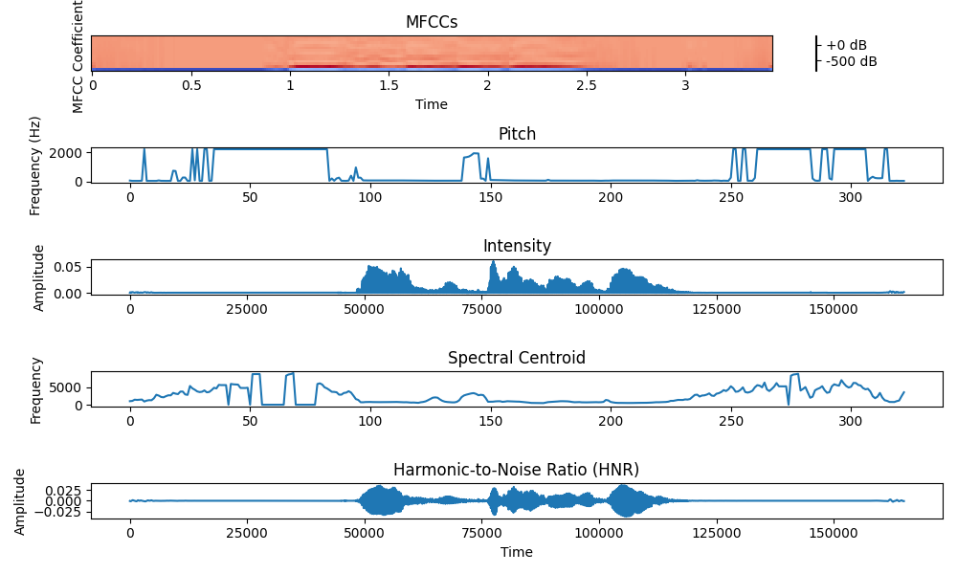

Slide 7

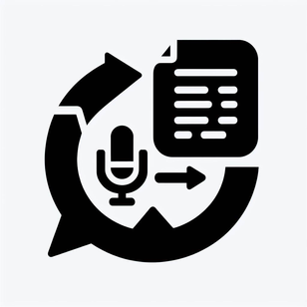



Intergration and Tool Development
Noise reduction
Feature Extraction
Separate dataset
Classify the emotions
Audio files

Slide 8

Evaluate the tool's performance under various conditions, including different speaking styles, accents and background noise levels.
01
02
Assess how well the tool handles challenging scenarios to ensure reliability in real-world applications.
02
Testing and Validation
03
Compare the tool's automated assessments of emotional states with manual assessments conducted by experienced SLPs.
03
04
Determine the level of agreement between the tool's predictions and human judgments to validate its accuracy and consistency.

Slide 9

Target
Speech language Pathologist

Slide 10



Ethical Considerations
Address privacy concerns related to audio recording and speech transcription, ensuring compliance with relevant regulations.
Protect the confidentiality of patient data and adhere to ethical guidelines in speech analysis and emotion identification.

Slide 11
Conclusion
This project aims to build an emotion recognition system for audio samples by collecting a labeled dataset, extracting relevant features, selecting and training a suitable classifier, evaluating its performance, fine-tuning for optimization and finally predicting emotions for new audio samples
By following the outlined approach and addressing ethical considerations, we can create a valuable tool that supports SLPs in providing effective care and improving outcomes for individuals with communication disorders

